Slide 1
Risk Management

Slide 2
Categories of risk
01
Framework for dealing with risk
02
Risk identification
03
Risk assessment
04
Risk planning
05
Risk management
06
Evaluating risk to the seclude
07
PERT
08
Monte Carlo simulation Critical chain concepts
09

Slide 3













What is a risk?

Slide 4
PM-BOK
“an Uncertain event or condition that occurs, has a positive or a negative effect on a projects objectives.”
Project
Management
Body
Of
Knowledge
PM-BOK is a project management standard published by the Project Management Institute in the USA

Slide 5
PRINCE2
“The chance of exposure to the adverse consequences of future events.”
PRojects
IN
Controlled
Environments
PRINCE2 is the UK government sponsored Project Management standard

Slide 6




Category of risks
Actors– People involved in development
Technology- Technology used to implement the application
Structure- Management structure and systems
Tasks- The work planned
Risks often arise form relationships between factors.

Slide 7

Planning for risk
1
Risk Identification
2
Risk analysis and prioritization
3
Risk planning
4
Risk monitoring

Slide 8


Risk identification
TOOLS:
Checklist
Brainstorming
&

Slide 9


Risk analysis and prioritization
Within the project there may be an endless amount of risks. We can distinguish the likely risks and their damage by estimating the Risk Exposure with this formula:
Risk Exposure =
(potential damage) x (probability of occurrence)

Slide 10







Risk Planning
Risk Acceptance
Risk Reduction
Risk Migration
Risk Transfer

Slide 11

Risk monitoring
When you decided which risks appear to be the most harmful to your project, you will then be expected to produce a Risk Assessment or Risk Register.
Risk description
Risk Impact
Risk migration plan
Probability of impact
Costs

Slide 12
Risk ID
Risk Title
Owner
Date raised
Risk Description
Impact Description
Recommended Risk Migration
Probability/Impact Values
Probability
Cost
Duration
Quality
Pre-migration
Post-migration

Slide 13

Case Study 1: Payroll Processing at Brightmouth College
Risks involved with “Off-the-shelf” software:
Time delay in installation
Software may be complex
Bugs
Adjustments may need to be implemented
Data transfer and conversion issues

Slide 14
Contingency
What is it?
Planned action to be carried out if a particular risk occurs
What is a contingency plan?
The steps you would take if the risk occurs
Always be prepared
May need to pay for a contingency plan

Slide 15
Is it worth it?
Risk Reduction Leverage (RRL)
Is this risk reduction cost effective?
RRL = (RE_{B} - RE_{A}) / Cost of risk reduction
RE_{B}: Risk Exposure before risk reduction has be taken
RE_{A}: Risk Exposure after risk reduction has be taken
RRL > 1.0, The reduction of risk is greater than the cost

Slide 16
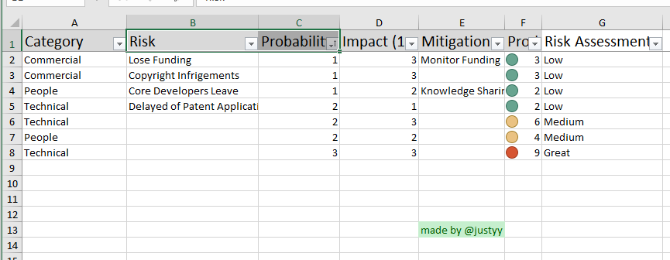
How to keep track of risks
Risk Register
A record of the most threatening risks to a project
Expect the size to change
Find new risk -> add to register
Risks no longer relevant -> remove from register

Slide 17
Case Study 1
Risk ID
0000
Risk Title
Instillation delay
Owner
Herbert
Date raised
14/1/2019
Risk Description
Delay in integrating payroll software for staff
Impact Description
Staff without pay
Recommended Risk Migration
Install in the beginning of working the year. Less data to be transferred.
Probability/Impact Values
Probability
Cost
Duration
Pre-migration
70%
£2500
14 Days
Post-migration

Slide 18
Scheduling with risks
If your initial time estimations don’t include risk
Be ready to compensate
How to include risk?
PERT
Take uncertainty into account
Monte Carlo Simulation
Take uncertainty into account (but better)

Slide 19
PERT
Program Evaluation & Review Technique
Similar to the Critical Path Method (CMP)
Has 3 estimations for duration of a task
Most likely time: m, time we expect to complete a task
Optimistic time: a, the shortest time possible
Pessimistic time: b, the longest time possible
T_{e}: Expected duration for the task
T_{e} = (a + 4m + b)/ 6

Slide 20
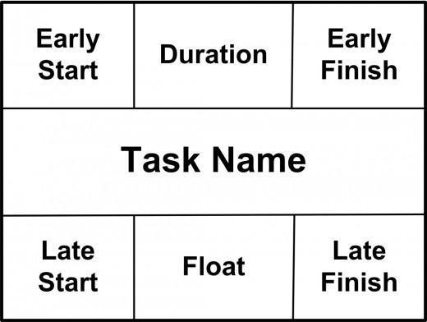
PERT
PERT node
The corners are dates
Duration: How long we calculated
Float: How long we can take a break
Nodes have many variations

Slide 21
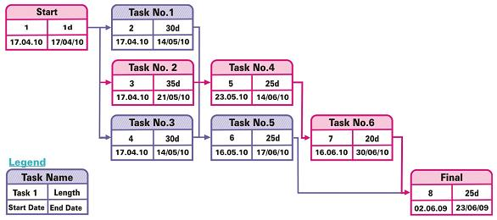
PERT Example

Slide 22
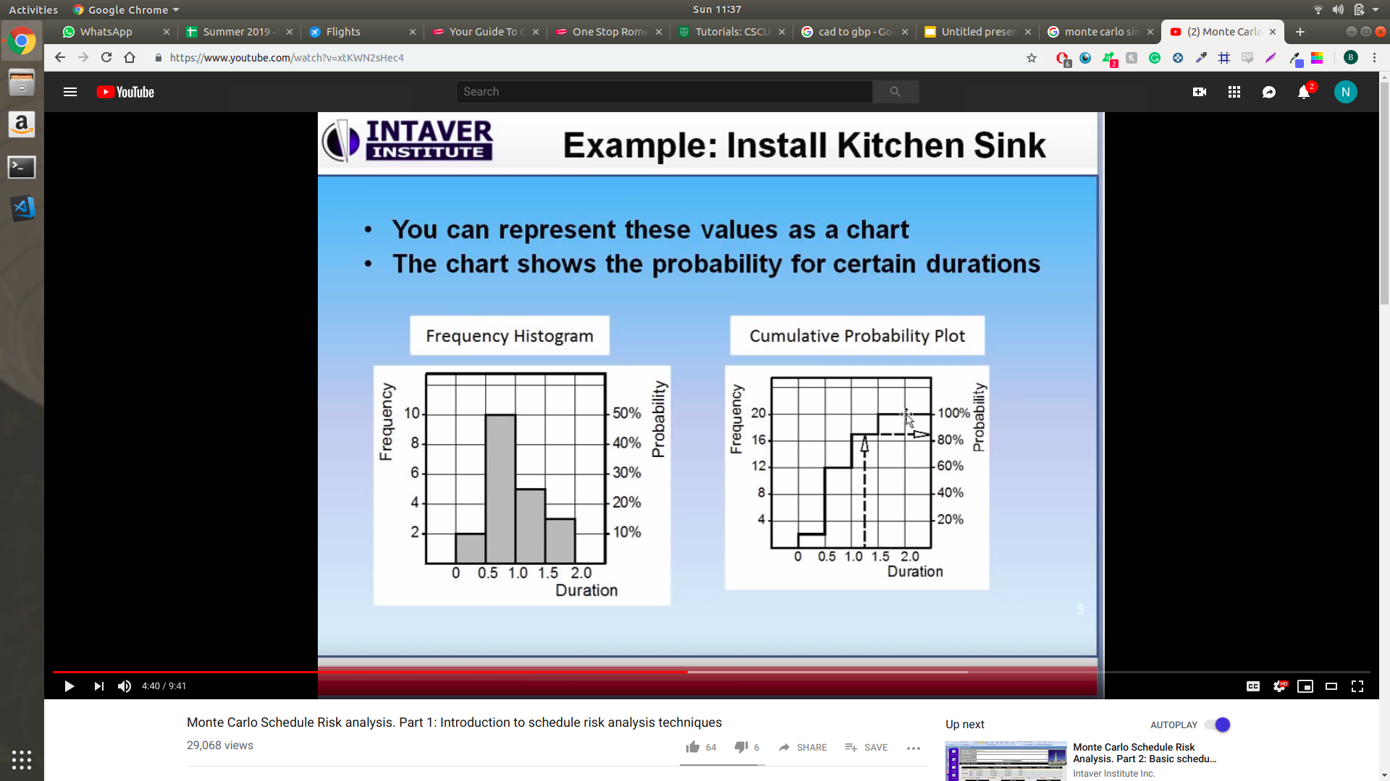
Monte Carlo Simulation
Much more realistic way of describing uncertainty
Building models using a probability distribution
How long has it taken to complete a similar task before
What are the most common time ranges
Frequency Histogram
Cumulative Probability Plots
Software is your friend

Slide 23
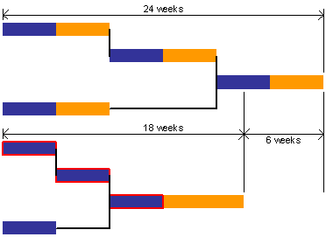
Critical Chain Concept
Resource focused
Steps
Estimate Time
Cut time in half Add to time to buffer
Track the buffer time

Slide 24
Case Study 1: Payroll Processing at Brightmouth College
Information Systems Development Officer, plan the project
Finding the risks
Creating risk register
Scheduling the appropriate dates
PERT
Monte Carlo
Critical Chain Concepts
Prove the worth of the “off-the-shelf”
RRL
If it’s not they should have a contingency plan
Finding different software
Evaluate their spending

Slide 25
References
Hughes and Cotterell, Software Project Management, 4th / 5th edition, Chapter 7
https://www.arrkgroup.com/thought-leadership/bespoke-or-off-the-shelf-software-a-comparison/
https://toughnickel.com/business/PERT-Chart-for-PM
https://www.management-hub.com/project-management-tools-pert-gantt-run-chart.html
https://www.palisade.com/risk/monte_carlo_simulation.asp

